Slide 1

Job Hunter
A Game About Getting a Job
Seb Kryspin

Slide 2


Why make a game about job-hunting?
Getting a job is considered a vital part of the human experience
Over 50% of students are worried about finding a job [4]

Slide 3
Getting a job can be fun(ny)!
Job Hunter will address fears of finding a job after graduation.
Wacky Characters
Sense of Humor
Laughter reduces anxiety, promotes learning [5]

Slide 4

Job Hunter: Gameplay basics
3D Platformer, Jump & Attack enemies
Student aiming to land a job
Defeat Interviewer
Infiltrate HR
Write Resume
Apply
Rescue Resume from Enemies

Slide 5
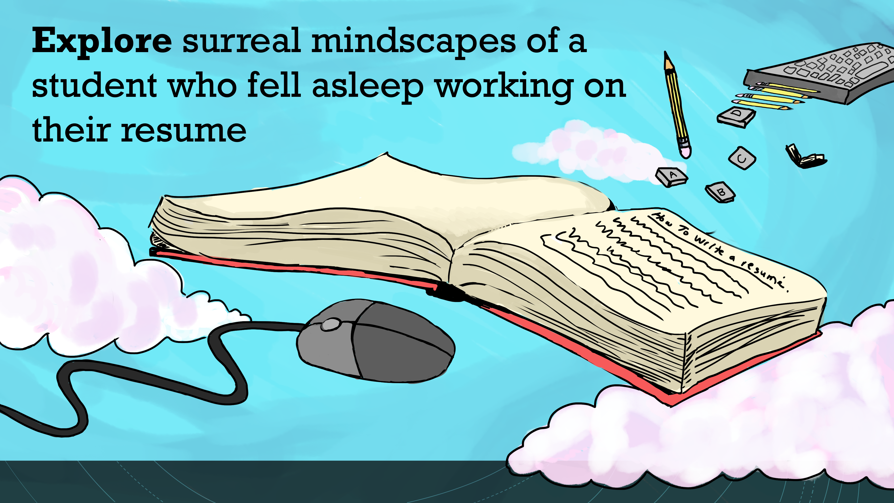
Explore surreal mindscapes of a student who fell asleep working on their resume

Slide 6
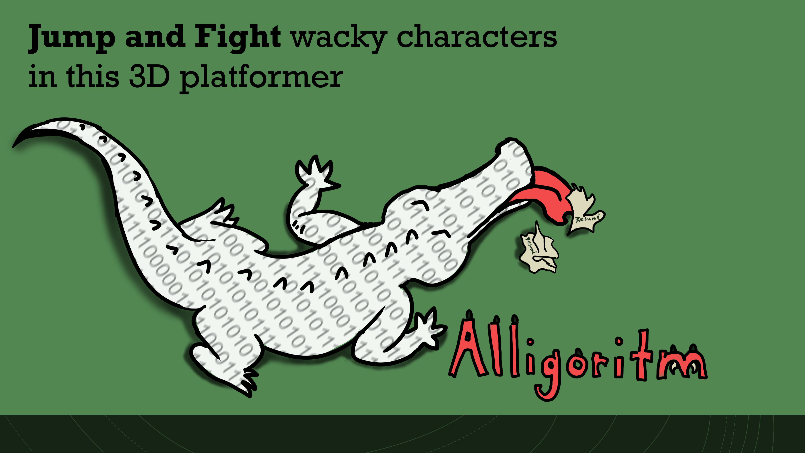
Jump and Fight wacky characters in this 3D platformer

Slide 7
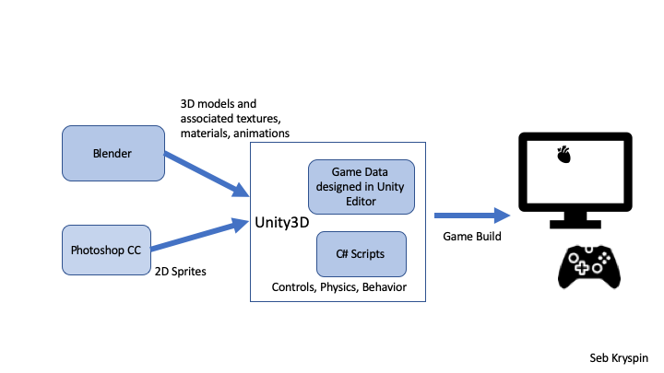
Building Job Hunter

Slide 8
Timeline
9/18 – 9/30 | 9/30-10/14 | 10/15 – 10/28 | 10/28-11/11
Basic Player movement / Mechanics
2+ Enemy Prototypes
Feedback - Level 1
Level 2
Level 1
Lvl Select UI
Camera Movement
Concept art
Start Learning Blender
Player attack 1
NPCs w/ dialogue

Slide 9
Timeline
11/11 – 11/26
January - April
Feedback - Level 2
Create 3D Models, Animations
Unity Lighting System
Feedback – Level 3 & Boss Battle
Refine Work so far
Textures
Boss Battle
Level 3
Performance Optimization
Particle Effects

Slide 10
Thank You

Slide 11
References
[1] Entertainment Software Association. 2019. 2019 Essential Facts About the Computer and Video Game Industry. Entertainment Software Association, Washington DC. Not cited in paper.
[2] Bureau of Labor Statistics. 2019. Table A-1. Employment status of the civilian population by sex and age. Retrieved September 14, 2019 from https://www.bls.gov/news.release/empsit.t01.htm
[3] Bureau of Labor Statistics. 2015. How the Government Measures Unemployment. Retrieved September 14, 2019 from https://www.bls.gov/cps/cps_htgm.htm#definitions
[4] Microsoft Surface. 2016. Two-thirds of university students worry about finding a job, study reveals. Retrieved September 14, 2019 from https://news.microsoft.com/en-gb/2016/09/16/two-thirds-of-university-students-worry-about-finding-a-job/
[5] Brandon M. Savage et al. 2017. Humor, Laughter, learning, and health! A brief review. Retrieved September 14, 2019 from https://www.physiology.org/doi/full/10.1152/advan.00030.2017
[6] Luther Elliot et al. 2015. More than Just a Game? Combat-Themed Gaming Among Recent Veterans with Posttraumatic Stress Disorder. Retrieved September 14, 2019 from https://www.ncbi.nlm.nih.gov/pmc/articles/PMC4601548/ Not cited in paper.
[7] Unreal Games. 2019. Unreal Engine 4 Commercial Game Deployment Guidelines. Retrieved September 14, 2019 from https://www.unrealengine.com/en-US/release
[8] ufo3d.com. 2019. Top 5 Modeling Software for Unity. Retrieved September 14, 2019 from https://ufo3d.com/3d-modeling-software-for-unity-top5
[9] Unity. 2019. Build Once, Deploy Anywhere. Retrieved September 14, 2019 from https://unity3d.com/unity/features/multiplatform

Slide 12
Software Hardware
U
Adobe Photoshop CC
Blender
Text editor
A computer capable of running the most recent version of Unity
A computer mouse for interfacing with Unity and Blender
A mousepad
Standard controller

